Slide 1
RAINFALL PREDICTION
Presented by: Faculty:
Prasanna Nimmani Mr.Ramesh dadi
2203a52114 stat-ml(aiml)

Slide 2
CONTENT
PROBLEM STATEMENT
INTRODUCTION
DATASET
IMPLPEMENTATION
> LINEAR REGREESION
> SUPPORT VECTOR MACHINE(SVR)
> KNN
> RIDGE REGRESSION
> LASSO REGRESSION
5. RESULT & COMPARISION
6. CONCLUSION

Slide 3
PROBLEM STATEMENT
DEVELOP A MACHINE LEARNING MODEL THAT ACCURATELY PREDICTS RAINFALL IN A GIVEN REGION BASED ON HISTORICAL WEATHER DATA AND RELEVANT ENVIRONMENTAL FACTORS.

Slide 4
INTRODUCTION
PROBLEM STATEMENT
PREDICT RAINFALL BASED ON A HISTORICAL WEATHER DATA USING MACHINE LEARNING
DESCRIPTION:
Rainfall forecasting is the task of predicting particular future rainfall amount based on the measured information from the past, including wind, humidity, temperature, and so on.
Rainfall prediction is a challenging task due to the complex nature of weather patterns. Machine learning techniques have been employed to predict rainfall based on atmospheric factors. One such example is the Rainfall Prediction using Machine Learning project.

Slide 5
The project utilizes Python libraries such as Pandas, Numpy, Matplotlib, and Scikit-learn. The dataset used in this project contains information about atmospheric factors and rainfall. The dataset is loaded into a Pandas dataframe for analysis and preprocessing. Data cleaning techniques are applied to handle outliers, null values, and discrepancies in the data inputs. Machine learning algorithms such as Support Vector Machine and Linear Regression are used to develop the prediction model. The model is trained and evaluated using techniques such as train-test split, standard scaling, and evaluation metrics.

Slide 6
Machine learning algorithms such as Support Vector Machine and Linear Regression are used to develop the prediction model. The model is trained and evaluated using techniques such as train-test split, standard scaling, and evaluation metrics. There are other methods for rainfall prediction, such as linear regression and machine learning techniques combined with numerical weather prediction models. Each method has its own advantages and limitations.

Slide 7
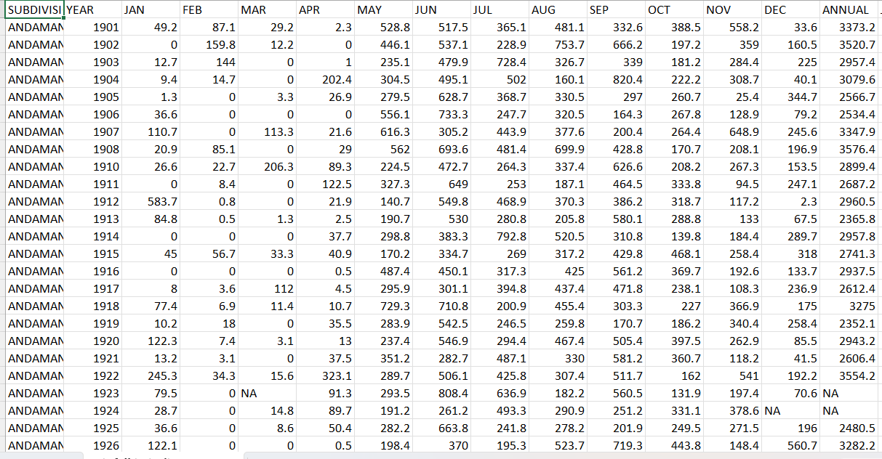
DATASET

Slide 8
ABOUT DATASET
The dataset is about rainfall prediction. Typically it consist of historical weather-related data, including various meteorological parameters, and the target variable is the amount of annual rainfall.
Dataset contains few columns named as Subdivision,Year,jan,Feb,Mar,Apr,May,Jun,Jul,Aug,Sep,Oct,Nov,Dec, Annual.
Annual column is the target for this data set containing varying integer values known as continuous values.
The shape of the data set is [4116 rows x 19 columns]. It means the no.of rows for each features columns and target column are 4116 and no.of columns are 19.

Slide 9
Here in the dataset the column named subdivision contains string values, so simply this column can be dropped using drop function to avoid error.
Check for any null values present in the provided dataset.If there are any null values found in the dataset in any row of any column fill them with either value to avoid error.
Now the dataset contains all float values.Therefore data is ready to implement machine learning algorithm.

Slide 10
IMPLEMENTATION
In the dataset the column named Annual is found as target.the values in the annual column are float values and they are quantitative as they are varying row to row.
The algorithm to apply for this dataset is REGRESSION as the target values found to be continuous. algorithms for regressioin are linear regression and svm interms of parametric method.
Algorithms for regression with parametric method:
Linear regression
Support vector machine(svR)
KNN
RIDGE REGRESSION
LASSO REGRESSION

Slide 11
LINEAR REGRESSION
Linear regression is a fundamental statistical and machine learning technique used to model the relationship between a dependent variable and one or more independent variables. It's called "linear" because it assumes a linear relationship between the variables.
In simple linear regression, you have one independent variable and one dependent variable. The goal is to fit a linear equation (a straight line) to the data points to make predictions. In multiple linear regression, you have more than one independent variable.

Slide 12
SUPPORT VECTOR MACHINE
SUPPORT VECTOR MACHINE OR SVM IS ONE OF THE MOST POPULAR SUPERVISED LEARNING ALGORITHMS, WHICH IS USED FOR REGRESSION AS WELL AS CLASSIFICATION PROBLEMS. HOWEVER, IT IS USED FOR BOTH REGRESSSION CLASSIFICATION PROBLEMS IN MACHINE LEARNING.
THE GOAL OF THE SVM ALGORITHM IS TO CREATE THE BEST LINE OR DECISION BOUNDARY THAT CAN SEGREGATE N-DIMENSIONAL SPACE INTO CLASSES SO THAT WE CAN EASILY PUT THE NEW DATA POINT IN THE CORRECT CATEGORY IN THE FUTURE. THIS BEST DECISION BOUNDARY IS CALLED A HYPERPLANE.

Slide 13
K-NEAREST NEIGHBORS(KNN)
K-Nearest Neighbors (K-NN) is a simple and effective machine learning algorithm used for both classification and regression tasks. It operates on the principle that similar data points are located near each other in a feature space. Here's how it works:
Training: K-NN doesn't have a traditional training phase. Instead, it memorizes the entire dataset, creating a reference for future predictions.
2. Prediction: To classify a new data point, K-NN calculates the distance (typically Euclidean distance) between the point and its K nearest neighbors in the training dataset.
3. Voting: For classification, it counts the number of data points in each class among the K neighbors. The class with the highest count becomes the predicted class. For regression, it averages the values of the K nearest neighbors.

Slide 14
4. CHOOSING K:THE CHOICE OF K IS A CRITICAL HYPERPARAMETER. A SMALLER K MAKES THE MODEL SENSITIVE TO NOISE, WHILE A LARGER K MIGHT OVER SMOOTH THE DECISION BOUNDARIES.
K-NN IS SIMPLE TO UNDERSTAND AND IMPLEMENT, BUT ITS PERFORMANCE DEPENDS HEAVILY ON THE CHOICE OF K, THE DISTANCE METRIC, AND THE QUALITY OF THE TRAINING DATA. IT'S A NON-PARAMETRIC AND INSTANCE-BASED ALGORITHM, MAKING IT ROBUST TO CHANGES IN THE DATA DISTRIBUTION. HOWEVER, IT CAN BE COMPUTATIONALLY EXPENSIVE FOR LARGE DATASETS SINCE IT REQUIRES CALCULATING DISTANCES TO ALL DATA POINTS DURING PREDICTION.

Slide 15
BOOT STRAPPING
Bootstrapping is a resampling technique widely used in statistics and machine learning to estimate the sampling distribution of a statistic, construct confidence intervals, and make robust predictions. The key idea behind bootstrapping is to create multiple resamples (bootstrap samples) from a single dataset, allowing for statistical inference without making strong parametric assumptions.
Here's how bootstrapping works:
Resampling: Given a dataset with n observations, bootstrapping involves randomly drawing n samples with replacement from the original dataset to create a bootstrap sample. This process is repeated to generate a large number of bootstrap samples (typically thousands).
2. Estimation: With the obtained bootstrap samples, you can compute statistics of interest, such as means, medians, variances, and confidence intervals. These statistics represent estimates of the population parameters based on the observed data.

Slide 16
3. INFERENCE: BOOTSTRAPPING PROVIDES A WAY TO QUANTIFY THE UNCERTAINTY ASSOCIATED WITH YOUR ESTIMATES. IT ALLOWS YOU TO CONSTRUCT CONFIDENCE INTERVALS BY ASSESSING THE DISTRIBUTION OF THE STATISTIC ACROSS THE BOOTSTRAP SAMPLES. BOOTSTRAPPING IS PARTICULARLY VALUABLE WHEN DEALING WITH SMALL SAMPLE SIZES OR WHEN THE UNDERLYING DATA DISTRIBUTION IS UNKNOWN OR COMPLEX. IT DOESN'T ASSUME SPECIFIC PARAMETRIC MODELS, MAKING IT A VERSATILE TOOL FOR A WIDE RANGE OF STATISTICAL ANALYSES. IT ALSO HELPS TO IDENTIFY OUTLIERS, ASSESS MODEL STABILITY, AND IMPROVE THE RELIABILITY OF MACHINE LEARNING ALGORITHMS BY ESTIMATING PREDICTION ERROR MORE ACCURATELY. HOWEVER, IT CAN BE COMPUTATIONALLY INTENSIVE WHEN A LARGE NUMBER OF BOOTSTRAP SAMPLES ARE REQUIRED FOR ROBUST RESULTS.

Slide 17
PRINCIPAL COMPONENT ANALYSIS(PCA)
Principal Component Analysis (PCA) is a dimensionality reduction technique used in data analysis and machine learning to simplify complex datasets while preserving essential information. It identifies and extracts the most influential patterns, reducing data dimensions and aiding visualization, noise reduction, and improved model performance.
Here's how PCA works:
Data Transformation: PCA takes a dataset with multiple correlated features and transforms it into a new coordinate system, represented by orthogonal axes called principal components. The first principal component (PC1) explains the most variance in the data, the second (PC2) explains the second most, and so on.
2. Variance Maximization: PCA calculates these principal components such that PC1 explains the maximum variance, PC2 explains the maximum remaining variance orthogonal to PC1, and so on. This helps to capture the most critical information in the data.

Slide 18
3. DIMENSION REDUCTION: RESEARCHERS OFTEN RETAIN A SUBSET OF THE TOP PRINCIPAL COMPONENTS, REDUCING THE DATASET'S DIMENSIONALITY WHILE RETAINING A SIGNIFICANT PORTION OF THE ORIGINAL DATA'S VARIANCE. THIS SIMPLIFIES SUBSEQUENT ANALYSIS.
4. VISUALIZATION AND COMPRESSION: PCA CAN HELP VISUALIZE HIGH-DIMENSIONAL DATA IN A LOWER-DIMENSIONAL SPACE. IT'S ALSO USED FOR DATA COMPRESSION, AS IT RETAINS MOST OF THE RELEVANT INFORMATION WITH FEWER FEATURES.
PCA HAS VARIOUS APPLICATIONS, INCLUDING IMAGE COMPRESSION, FEATURE SELECTION,NOISE REDUCTION, AND ANOMALY DETECTION. IT'S ESPECIALLY USEFUL WHEN WORKING WITH DATASETS WITH MULTICOLLINEARITY OR WHEN YOU WANT TO UNDERSTAND THE UNDERLYING STRUCTURE OF THE DATA. HOWEVER, INTERPRETING THE MEANING OF PRINCIPAL COMPONENTS CAN BE CHALLENGING, AS THEY ARE LINEAR COMBINATIONS OF THE ORIGINAL FEATURES. ADDITIONALLY, IT ASSUMES THAT THE DATA IS NORMALLY DISTRIBUTED, AND OUTLIERS CAN AFFECT RESULTS.

Slide 19
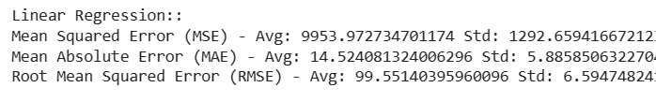
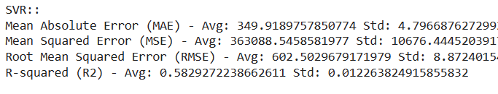
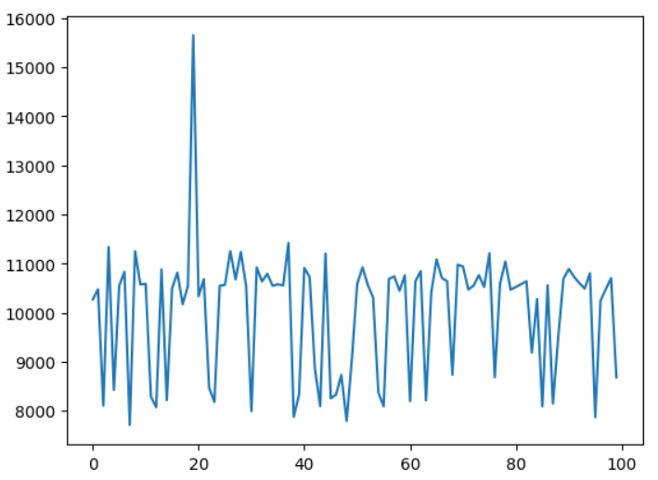
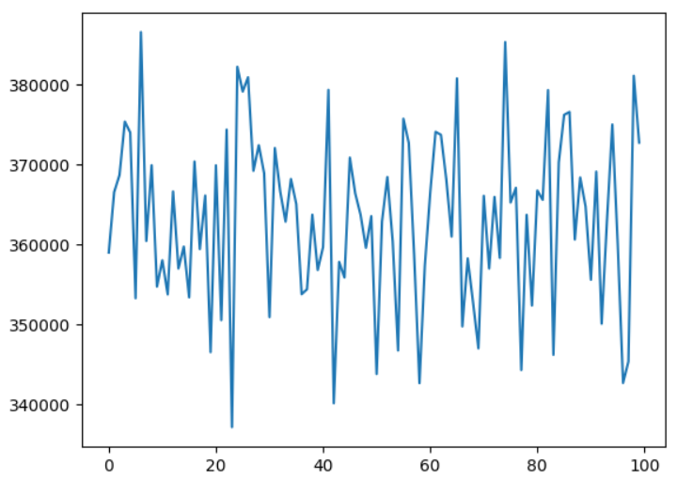
RESULT ANALYSIS
LINEAR REGRESSION: SVR:

Slide 20


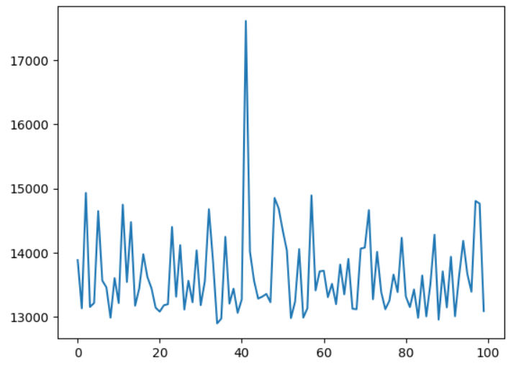
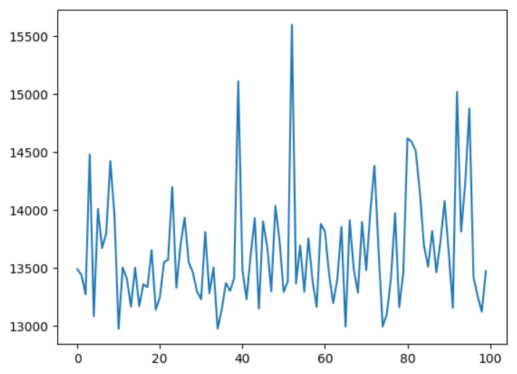
Ridge regression: Lasso Regression:

Slide 21

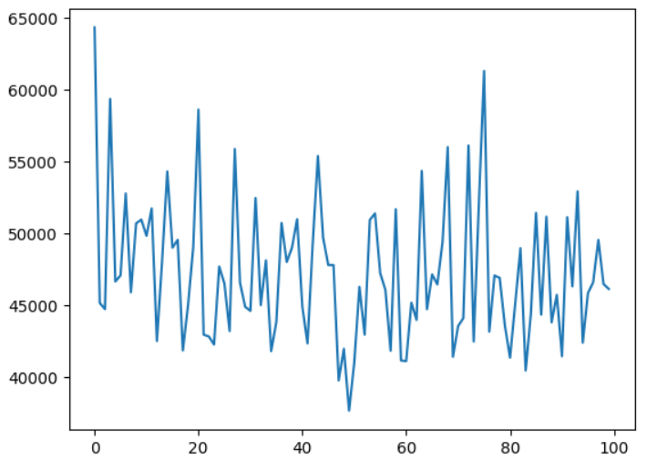
KNN:

Slide 22
CONCLUSION
This project , rain fall prediction concentrated on estimation of amount rainfall and it is concluded that linear regression, has mean squared error 9953, SVR mean squared error is 349, Ridge regression mean squared error is 13692, Lasso Regression mean squared error is 13648, knn mean squared error is 47289.
I can conclude that “support vector machine “ Algorithm model best fits for this Rainfall prediction dataset.because it produced least mean squared error as 349 compared to all the remaining algorithms.

Slide 23
GITHUB LINK
https://github.com/Prasannanimmani/project.git

Slide 24
THANK YOU

